Slide 1
Error Correcting Codes for High Altitude Balloons
Matthew Brejza

Slide 2
Examples of Code Applications
Application | Code | Rate
DVB-T (digital TV) | Reed Solomon & convolutional | 1/2 -> 7/8
DVB-T2 / DVB-S2 (digital TV) | LDPC & BCH | 1/2 -> 5/6
LTE | Turbo
WiMAX | Turbo or LDPC
Voyager | Convolutional (k=5) | 1/2
Mars Pathfinder/Cassini probe | Convolutional (k=7) | 1/6

Slide 3
A Very Basic Code
01101
000 111 111 000 111
+
010 110 111 011 011
01111
noise
Repetition code
1/3 rate code
Encoder: simple
Decoder: simple
Performance: bad

Slide 4
An Improvement
channel
0 1 1 0 1
0 1 1 0 1
0 1 1 0 1
-2 | 3 | 1 | -5 | -1
2 | 4 | 5 | 2 | 3
-3 | -2 | 2 | 1 | 2
01101
+
Demod
-3 5 8 -2 4
0 1 1 0 1
noise
Soft information conveys probabilities for each bit
Usually expressed in the log domain, numbers have much smaller dynamic range
Known as Log Likelihood Ratio (LLR)

Slide 5
Reed Solomon (RS) Code

Slide 6
BER Graphs

Slide 7
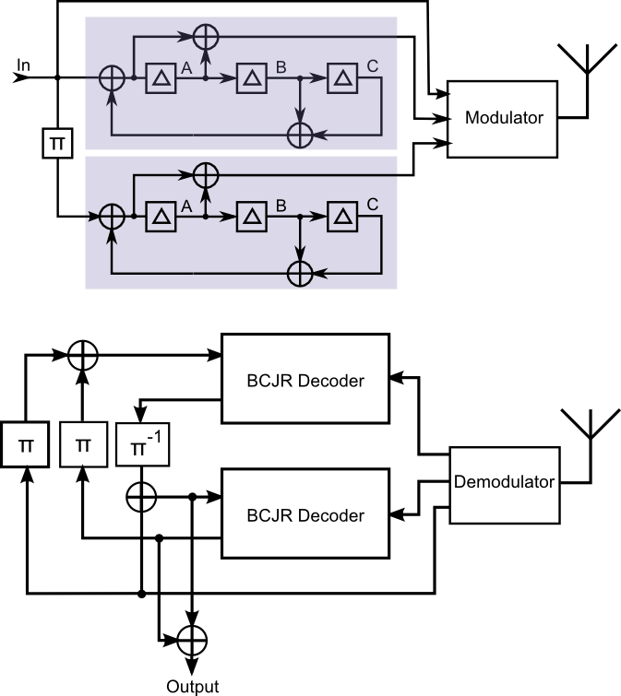
Turbo Code
Combines two convolutional codes
1/3 rate code (min)
Uses soft information

Slide 8
BER – SNR&Eb/N0

Slide 9
Why needed on hab

Slide 10
Capacity

Slide 11
FER

Slide 12
FER - fading

Slide 13
BPSK, FSK and MFSK

Slide 14
Potential New Telemetry String
Parity 1
Parity 2
Parity 3
Parity 4
Sync + callsign
Length + packet info
GPS
Other telemetry
Checksum
Sync
Sync + callsign
(next packet)
Send as many as needed
Turbo code – R ∈ {⅓, ⅖, ½, ⅔, 1}
Parity bits interleaved and split into four groups
Send as many as needed depending on stage of flight
Ideally keep the same length (of the data part) throughout flight

Slide 15
Concluding Remarks

Slide 16
Questions?

